Slide 1
Azure Architect Workshop
Enterprise Web Apps Case Study
Tiberiu Covaci

Slide 2

Rules of Engagement
Wi-Fi is available
Analyze requirements, discuss, iterate, design, present solution. Raise clarifications
Fully participate to make this a great experience for everyone

Slide 3
Step 1: Review the Customer Case Study
Enterprise
Web Apps
Outcome
Analyze you customer’s needs.
Timeframe
10 minutes

Slide 4
Customer Situation Contoso Corp
Enterprise
Web Apps
Founded in 1982, Contoso Corp has grown from a boutique manufacturer of high-quality widgets into one of the world’s largest makers of premium widget products.
Most of the company’s IT infrastructure is located in the company’s Carlsbad, California, headquarters, but Contoso also has a sizable third-party colocation datacenter, costing US$30,000 to $40,000 a month, and other servers scattered around the United States.
Contoso knows that its datacenters are filled with dozens of smaller web servers and databases that run on underutilized hardware, and it has customer data scattered in multiple places. Faced with the prospect of a very large capital expenditure owing to the fact that the vast majority of their servers are now due for a hardware refresh, Contoso is looking for other options that eliminate the costly and high risk hardware refresh cycles.
Scaling the infrastructure takes significant time. “During and after a high-profile marketing event, there’s a great deal of interest in our product, and our websites receive a lot of hits,” says the Manager of Solution Development. “It is difficult to scale our web hosting environment fast enough, and consumers and resellers could experience slow response times and even downtime.”
Contoso conducts weekly server hardware maintenance, which causes downtime for some of its global offices.

Slide 5
Customer Situation (continued)
Enterprise
Web Apps
Contoso wants to move many consumer-facing websites, enterprise databases, and enterprise web services to Azure. “By using Microsoft global datacenters, we’re able to move infrastructure for key applications and websites closer to the people who use them.”
A big problem for Contoso is resellers and consumers in Japan and China have to use applications that run in a Texas datacenter, and because of the distance, encounter performance problems. Contoso would like to resolve this without the difficulty, expense and time requirements incurred by setting up infrastructure on the other side of the world using Contoso-owned servers.

Slide 6
Customer Situation (continued)
In reviewing all of Contoso’s databases, it was determined that there were three archetypical databases present:
Product Catalog: these databases were 50-100GB in size, grew only about 5% per year and experienced a moderate, primarily read-only load (on the order of 10’s of transactions per second) from the Website.
Inventory: these databases were in the 3-5 TB range in size and grew less than 1% per year. They have a very heavy read/write load, with writes commonly requiring 2,000 IOPS and reads often climbing over 8,000 IOPS.
Departmental: these databases were typically used by web applications supporting the regional offices only, and had fairly low demands (on the order of a dozen transactions per hour), with data sizes in the 500MB-1GB range. Contoso has 1000’s of these databases, and fully expects new database to be created to support departmental efforts.

Slide 7
Customer Needs
Improve the performance for customers and resellers accessing its websites around the world
Support for easily provisioning resources to meet bursts of demand
Consolidate and improve the utilization of website and database hosting resources
For their most demanding databases, they want to migrate without having to re-architect their database structure or make large changes to the application.
Avoid downtime, particularly that caused by web and database server patching

Slide 8
Customer Objections Scale and Performance
I do not want to have to make code changes (or re-deploy) in order to change the scale of a website.
I hear Azure Web Apps is only useful for websites with small amounts of traffic; will it really support the heavy traffic we receive?
We would prefer to avoid performing a database migration (e.g., to another server) in order to scale the throughput of our database.
We have heard SQL Database does not provide consistent performance, is this true?

Slide 9
Customer Objections Business Continuity
How can we be certain our data will survive in the event of a catastrophe in a certain part of the world?
We need to be able to recover from mistakes made by administrators that accidentally delete production data (we know they happen, we would love an “undo”).

Slide 10
Customer Objections Connectivity
Some of our enterprise web services need to access data and other services located on-premises, is this supported?
How can we ensure we are delivering the lowest latency possible to our website visitors?
We need to ensure that if we have multiple web servers backing a given website, that no one web server gets all the traffic.

Slide 11
Customer Objections Management
We would prefer not to have to manage patching of web servers and databases.
With all of our websites and databases around the world, how do we keep tabs on which is up and which is down and which is struggling?

Slide 12
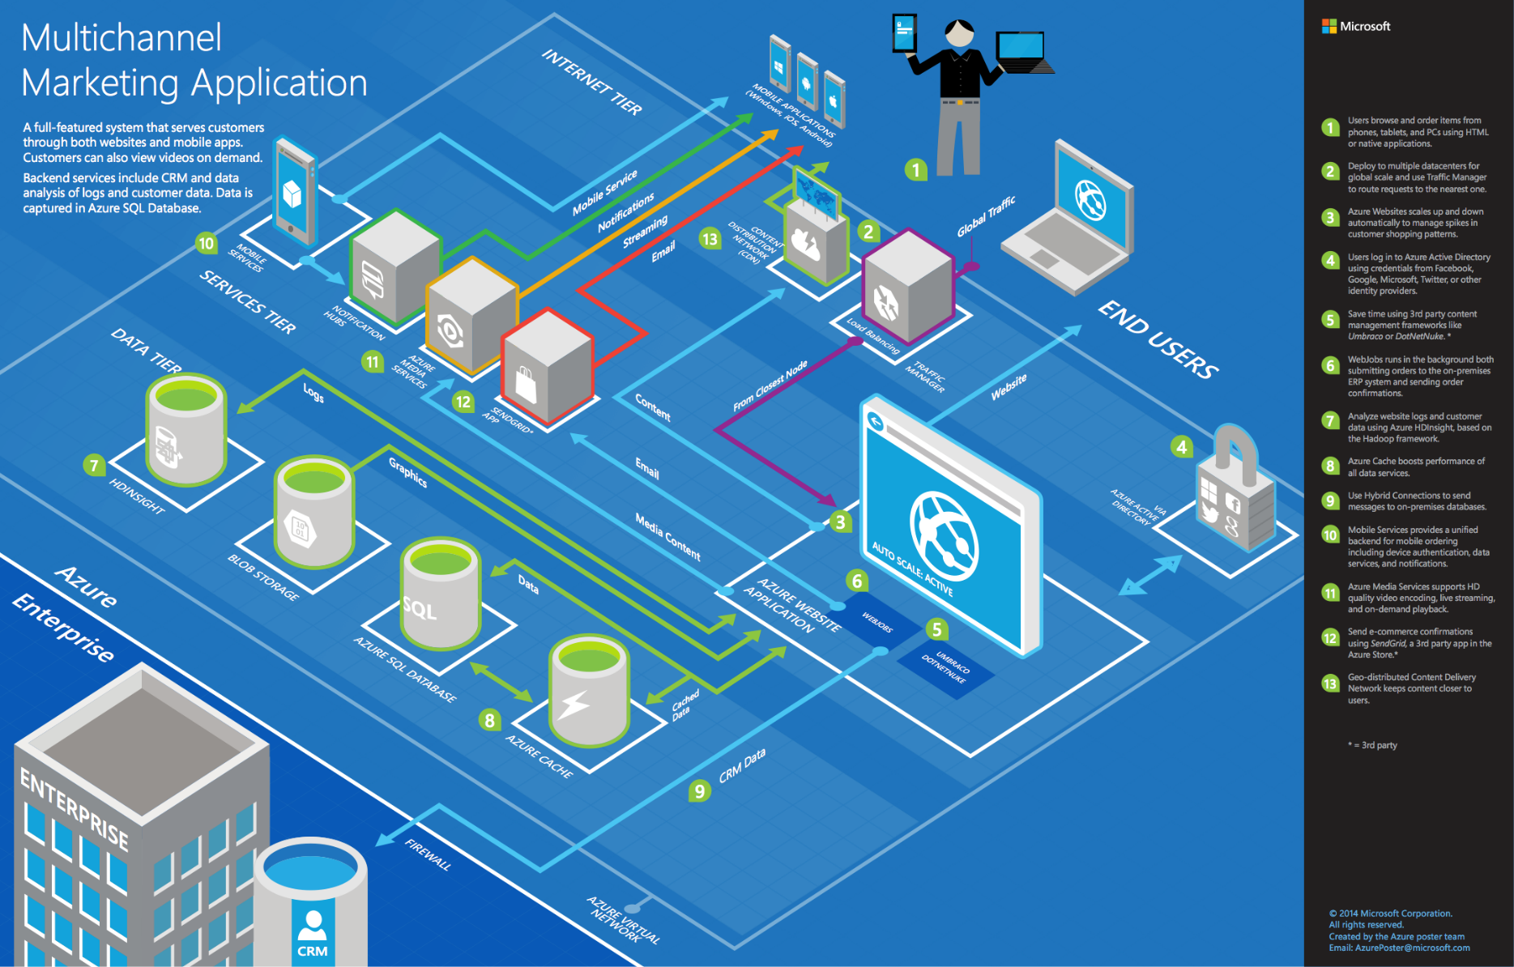

Slide 13
Step 2: Call to action – Design the solution
Enterprise
Web Apps
Outcome
Design a solution and prepare to present the solution to the target customer a 10-minute chalk-talk format.
Timeframe
40 minutes
Business Needs (5 minutes) | Respond to questions outlined in your guide and list the answers on a flipchart.
Design (30 minutes) | Design a solution for as many of the stated requirements as time allows. Show the solution on a flipchart.
Prepare (5 minutes) | Identify any customer needs that are not addressed with the proposed solution. Identify the benefits of your solution. Determine how you will respond to the customer’s objections. Prepare to verbally brief presentation to the customer.

Slide 14
Step 3: Call to action – Present the solution
Enterprise
Web Apps
Outcome Present a solution
Timeframe
10 minutes
Directions
Switch proctors and two member of your team with another table.
Present proposed solution to the customer.
The customer asks one of the objections from the list of objections in the case-study.

Slide 15
Wrap-Up
Enterprise
Web Apps
Outcomes
Identify the potential solution for the case-study.
Identify solutions designed by other teams.
Timeframe
10 minutes

Slide 16
Requirements Recap
Enterprise
Web Apps
Requirement | Optional (Y/N)
No code changes or re-deploy to change scale | N
Support heavy amounts of traffic | N
Avoid database migration to scale throughput of database | N
Consistent performance for database | N
Survive data in event of a regional catastrophe | N
Recover from mistakes by admins (an undo button) | N
Connect to on-prem resources | N
Ensure lowest latency possible | N
Ensure load-balancing across web sites | N

Slide 17






Consumer Web App – Preferred Solution
http://contosowest.azurewebsites.net
DNS Provider
http://contoso.trafficmanager.net
2
1
http://contoso.com
Product Catalog
CRUD
Blobs
Azure SQL Database Premium
(Active Primary)
3
Async replication
http://contoso.trafficmanager.net
http://contosojapan.azurewebsites.net
http://contosoEU.azurewebsites.net
http://<host>.azurewebsites.net
4
Product Catalog
Product Catalog
Blobs
Blobs
READ
READ
Traffic Manager
(Performance Profile)
Azure SQL Database Premium
(Read only secondary)
Azure SQL Database Premium
(Read only secondary)
Japan West
West Europe

Slide 18


Departmental Web App Preferred Solution
Regional Office - Greenfield
Regional Office - Brownfield
SQL 2014
Department Web App 1
Department Web App
App1
Azure SQL Database - Basic
Department Web App 2
App2
App3
Department Web App n

Slide 19




Inventory Web App Preferred Solution
VPN Gateway
Virtual Network
VPN Device
Domain Controller

Slide 20
